Slide 1
MICROSOFT MOVIE STUDIO PROSPECT
Presneted By :
Weru Stanley

Slide 2
BUSINESS PROBLEM
Microsoft sees all the big companies creating original video content and they want to get in on the fun. They have decided to create a new movie studio, but they don’t know anything about creating movies. You are charged with exploring what types of films are currently doing the best at the box office. You must then translate those findings into actionable insights that the head of Microsoft's new movie studio can use to help decide what type of films to create.

Slide 3
DATA
The relevant data was gotten from :
- Box Office Mojo https://www.boxofficemojo.com/.
From Box office we get : studio names and gross sakes
- IMDB https://www.imdb.com/.
From IMDB we get : ratings, runtime and genres

Slide 4
LEAD QUESTIONS
Which is the best rated genre; most profitable genre, genre with highest ratings?
Which are the most expensive genres and cheapest genres to produce?
What is the correlation between runtime and ratings?
What is the correlation between runtime and budget ?

Slide 5
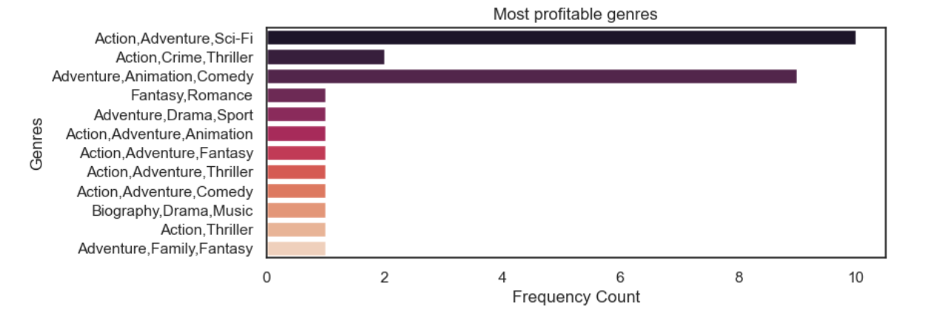
Most Profitable Genre.
The most profitable genre is Action,Adventure,Sci-Fi.

Slide 6
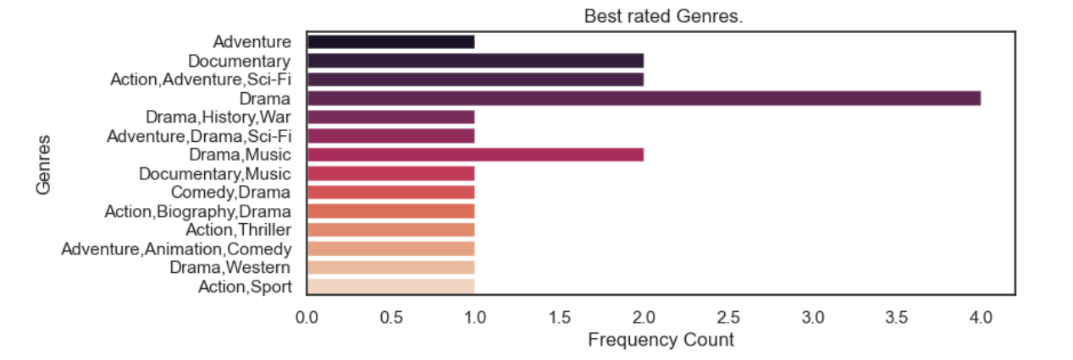
Genre with the highest Ratings
The best rated genre is Drama and Action,Adventure,Sci-Fi.

Slide 7
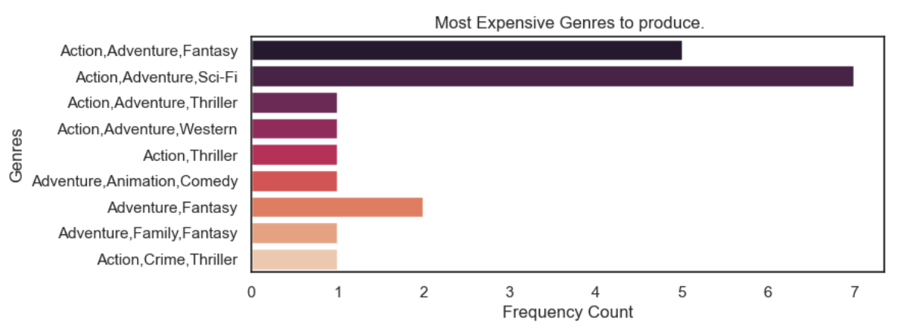
MOST EXPENSIVE GENRE
The cateogory of action adventure movies are the most expensive to produce. Action,Adventure,Sci-Fi. being the most expensice action adventure movie to produce

Slide 8
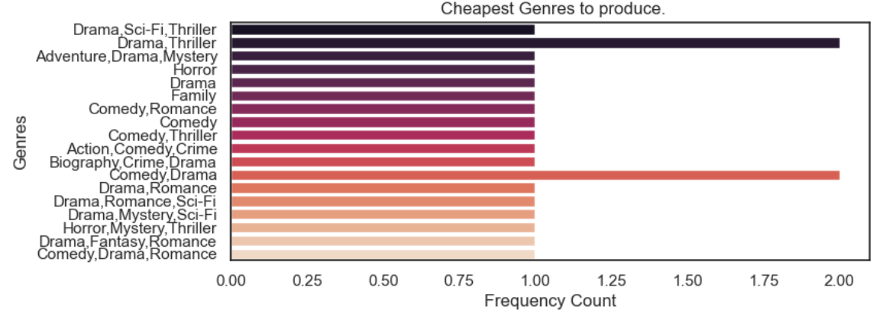
CHEAPEST GENRE
Drama, comedy and thriller movies are the cheapest to produce.

Slide 9
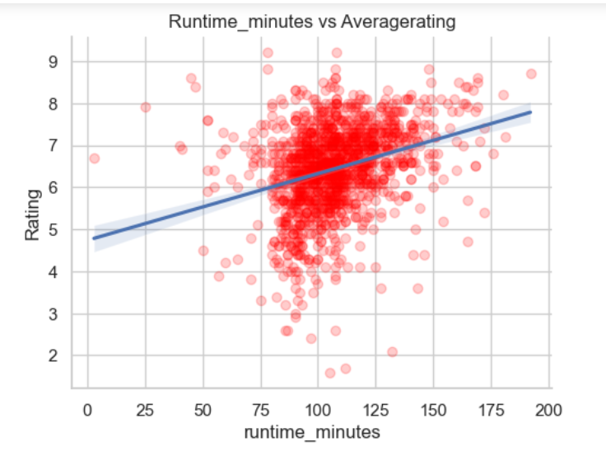
Correlation between Runtime and Ratings
There is weak positive correlation between ratings and runtime. A correlation of 0.301153.

Slide 10
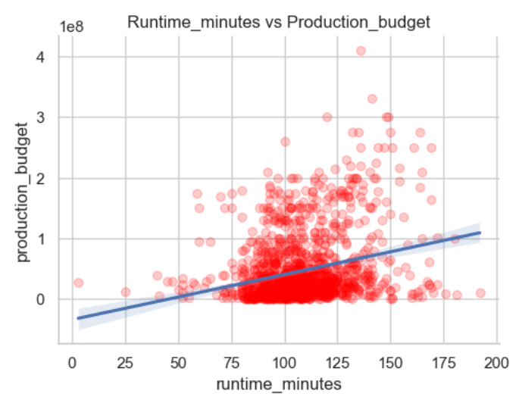
Correlation between Runtime and Budget
There is a weak positive correlation between budget and runtime. This implies that that as runtime increaes, the budget increases.

Slide 11
Recommendations.
1.Microsoft studios can choose to produce either Drama or Action,Adventure,Sci-Fi.
2.Microsoft should commission another study to recommend the best distribution channel for its movies. We could not do this since the data was not available.

